Slide 1




“”
THINK YOU CAN’T AFFORD COLLEGE?
THINK AGAIN.
Notes:
This presentation can be used by a school counselor or teacher to help alert students in 6th through 8th grade to the existence of the College Bound Scholarship.
Eligible students must apply for the scholarship by June 30th of their 8th grade year.
More information is available at the WA Student Achievement Council web site.

Slide 2

Post Secondary Pathways
What is your E?
To explore is to set an amount of time for planned practical learning like learning another language or traveling to another country.
Enrollment is registering for a 4-year university or 2-year community or technical college.
Students interested in the employment pathway are ready to join the workforce immediately after high school..
Enlistment is joining one of the US military branches, including the Army, Navy, Air Force, Marines, and Coast Guard.

Slide 3
Raise your hand if you think you will enroll in a
2-year college or 4-year university after high school.
Why are you choosing to further your education?
Why are you choosing not to further your education?

Slide 4
Average Yearly Income by Education Level
Education Level | Average Yearly Income
Doctoral Degree | $101,232
Master’s Degree | $83,376
Bachelor’s Degree | $71,664
Associate’s Degree | $50,784
Some college, No degree | $47,616
High School Diploma | $43,152
Less than a high school diploma | $33,984

Slide 5
Average Prices for products in 2024
$999 = iPhone 16 Pro
$1000 = A laptop with a fast processor, 16 GB of RAM, good for video editing, moderate gaming, and multitasking.
$1400 = Rent for a one-bedroom apartment in Tacoma, WA
$4500 = Trip for two to Hawaii including flights, lodging, food, and some island-hopping transportation.
$7000 = A good quality 1-carat diamond engagement ring
$20,000 = Average cost of a 5-year-old used Honda Civic
$38,000 = Average cost of a new Ford pickup truck
$39,000 - $200,000 = Price range for a new Tesla

Slide 6
“”
THINK YOU CAN’T AFFORD COLLEGE?
THINK AGAIN.
Notes:
This presentation can be used by a school counselor or teacher to help alert students in 6th through 8th grade to the existence of the College Bound Scholarship.
Eligible students must apply for the scholarship by June 30th of their 8th grade year.
More information is available at the WA Student Achievement Council web site.

Slide 7

WHAT IS THE
COLLEGE BOUND SCHOLARSHIP?
It’s a PROMISE:
free college tuition!
You must sign up by the end of 8th grade
You must be eligible
You must promise to prepare for college
Notes:
Explain that the College Bound Scholarship offers the promise of tuition and books to qualifying 7th and 8th graders in Washington.
This scholarship covers the amount of tuition (at public college rates) not covered by other state financial aid, plus a small book allowance. It can be used at two-or four-year public and private colleges and universities.
In return for this promise, students must:
Sign up by the end of 8th grade
Be income-eligible (see next slide)
Promise that they will prepare for college and attend college

Slide 8
WHO IS ELIGIBLE?
You are eligible if you:
Receive free/reduced price lunch
Are a foster youth
Receive TANF benefits
Meet the family income requirements on the table
Family Size | 2010 Income (Maximum) | Monthly Income
2 | $27,200 | $2,300
3 | $34,300 | $2,900
4 | $41,300 | $3,400
5 | $48,400 | $4,000
6 | $55,500 | $4,600
7 | $62,600 | $5,200
8 | $69,600 | $5,800
More family members | +$7,000 | +$600
Notes:
Explain that students are eligible if they:
* Receive free or reduced price lunch OR
* Are a foster youth OR
* Their family receives TANF benefits OR
* Their family income meets the income requirements on the chart on the slide.
Tell students that they must be eligible and that their family’s income will be verified during their senior year to determine their financial eligibility for the scholarship.

Slide 9
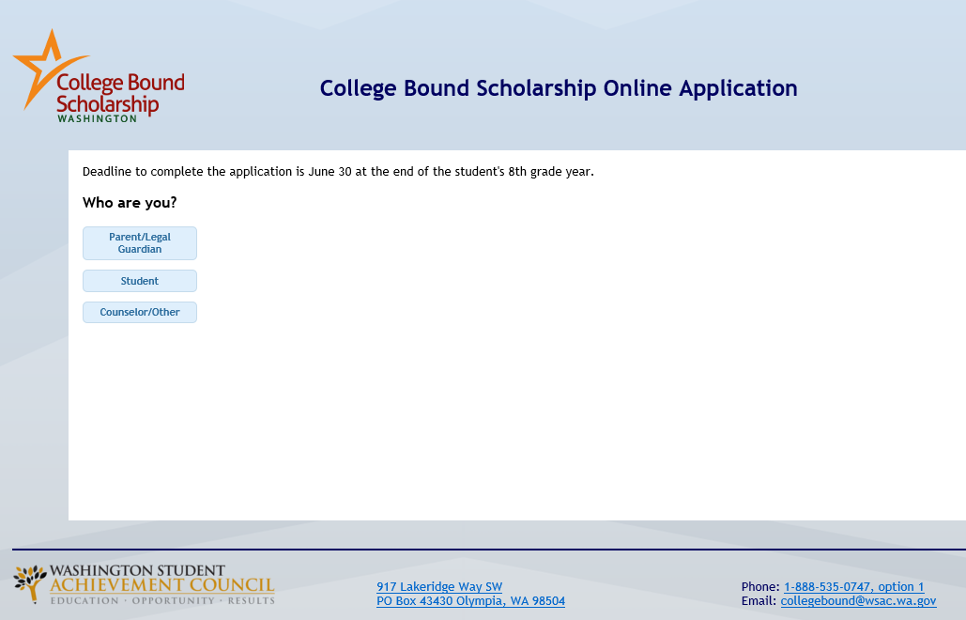
HOW DO YOU APPLY?
Apply during 7th or 8th grade
Apply online
(use paper form if needed)
Sign a pledge form
Ask a teacher or counselor for help if
you want to apply
Notes:
Tell students that they must apply during the 7th or 8th grade. They will complete and sign an application and pledge form.
Students can apply online at WA Student Achievement Council’s website.
Remind them that applying online is better because it is faster, easier, and more accurate than applying on paper.

Slide 10

WHAT WILL YOU PLEDGE?
Graduate from high school with 2.0 GPA or higher
Be a good citizen and stay crime free
Apply for college
Submit a FAFSA
(financial aid application)
Notes:
Students will need to sign a pledge when they apply for the scholarship. The pledge says that the student will:
Graduate from high school with a cumulative 2.0 GPA or higher.
Be a good citizen and stay crime free.
Apply for college.
Submit a FAFSA (Free Application for Federal Student Aid) during senior year
(Note: Students who complete the WAFSA are eligible for College Bound Scholarship with DACA Status – See WA Student Achievement Council/Ready, Set, Grad site for additional information.)

Slide 11

WHAT HAPPENS NEXT?
You’ll get a certificate
It is a promise to you
Your scholarship will be ready when it is time for college
Now work hard in high school!
Notes:
Tell students that after they apply they will receive a certificate in the mail. This certificate is a pledge from the State of Washington that, as long as the student meets his or her promise and remains income eligible, that the student will receive tuition for college.

Slide 12
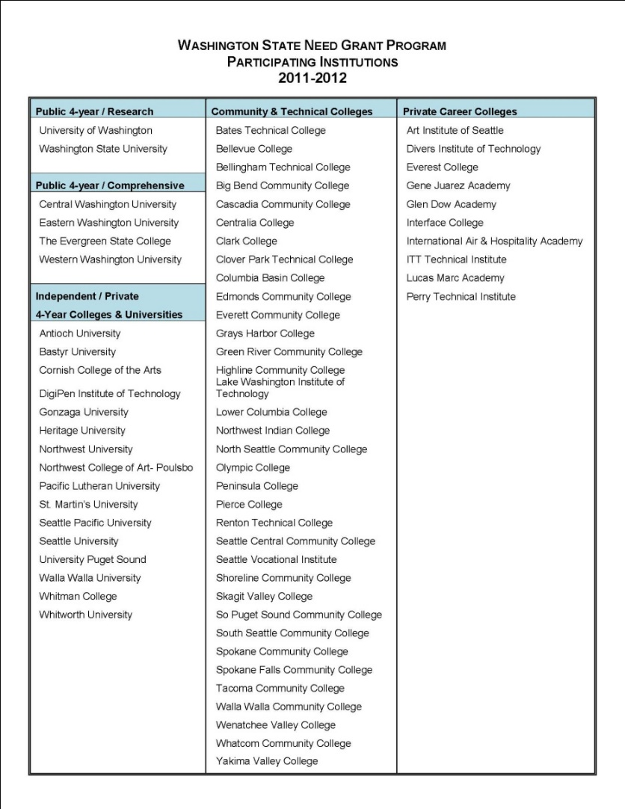
WHERE CAN YOU USE IT?
More than 68 eligible institutions
Your choice of 4-year or
2-year college
Your choice of public or private
Notes:
Your students are probably way too young to know much about different college. But, as you show this list, you can assure them that many public and private four-year colleges and universities participate in the College Bound Scholarship.
Tell students that if they decide that they want to attend a community or technical college or career school instead of a four-year college, that there are 68 eligible colleges where they can use the College Bound Scholarship!

Slide 13
CAN YOU MEET THE CHALLENGE?
“Every single one of you has something to offer.”
“And you have the responsibility to yourself to discover what that is.”
“That’s the opportunity an education can provide…”
Notes:
Read the quote on the screen to inspire your students:
President Barack Obama, September 8, 2009

Slide 14

ARE YOU COLLEGE BOUND?
Notes:
End by reminding students of the contact information for the College Bound Scholarship on the WSAC for their parents to read.

