Slide 1
The Role of Government Policies in Laos' Shift from Subsistence Farming to Commercial Agriculture
By Sengravi Tiara Phakoxay

Slide 2
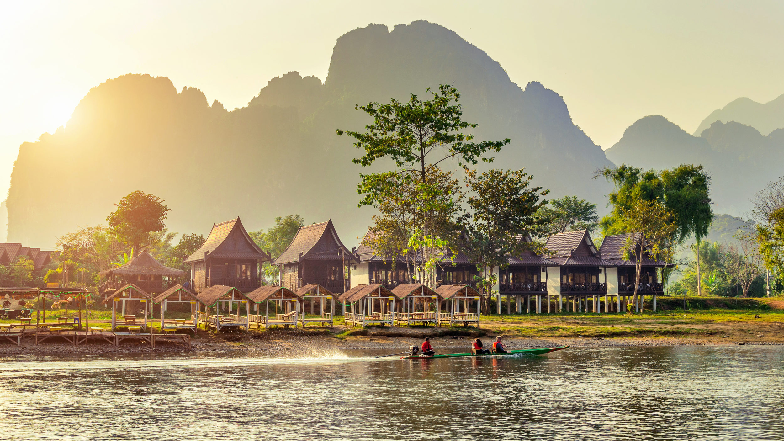
Roadmap
Geography
Subsistence Farming Culture
Terrain
Agricultural and Economic Growth
Poverty and Food Insecurity
Effect on Environment
Recommendations
U.S. Department of State. (2024). Laos - United States Department of State. State Government.

Slide 3

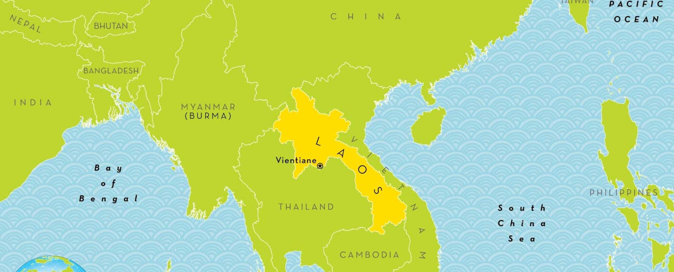
C
Geography
Wright, A. (n.d.). Laos Country Map. National Geographic Kids. National Geographic.

Slide 4
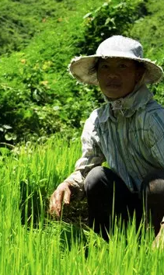
Subsistence Farming Culture
Subsistence Farming Ethics (Evans, 2002).
Nearly half of the population continues to practice subsistence ethics (Rehbein, 2021).
Houythao, B. (2014). The New Humanitarian.

Slide 5
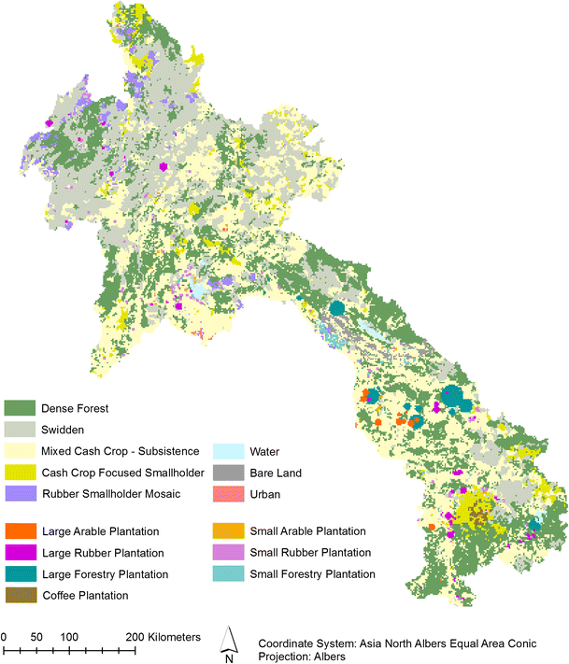
C
Terrain
Debonne, N., van Vliet, J., Heinimann, A., & Verburg, P. H. (2018). Land system map of Laos in 2010. Research Gate.

Slide 6
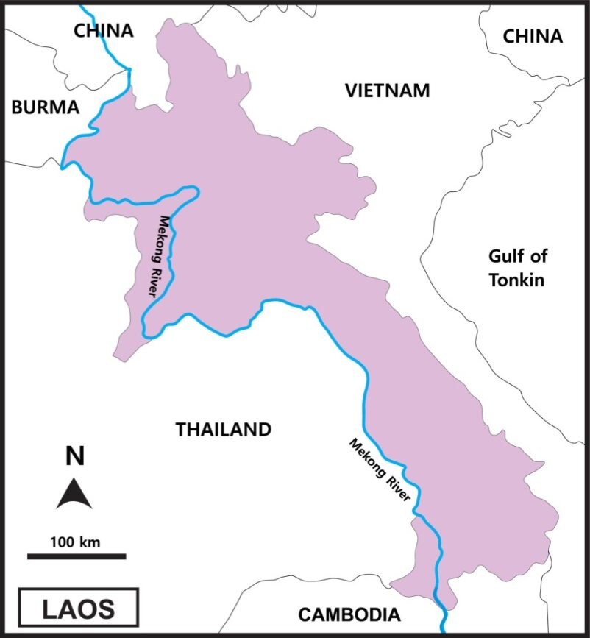
C
Mekong River
Eezy. (n.d.). Map of Laos. Vecteezy.

Slide 7
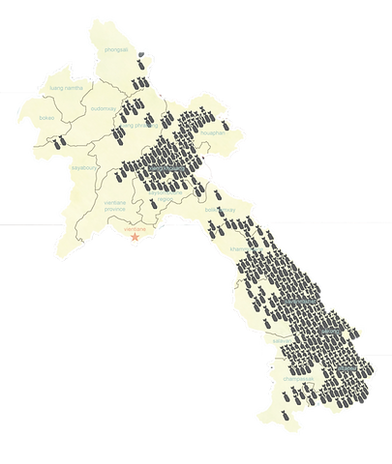
UXO in Laos
UXO
  Unexploded ordnance.
  78 million UXO remained.
  37% of Laos' land covered but current estimates go up to half.
Home. Legacies of War. (2023).
Khamvongsa, C., & Russell, E. (2009). Legacies of War. Critical Asian Studies, 41(2), 281– 306.

Slide 8
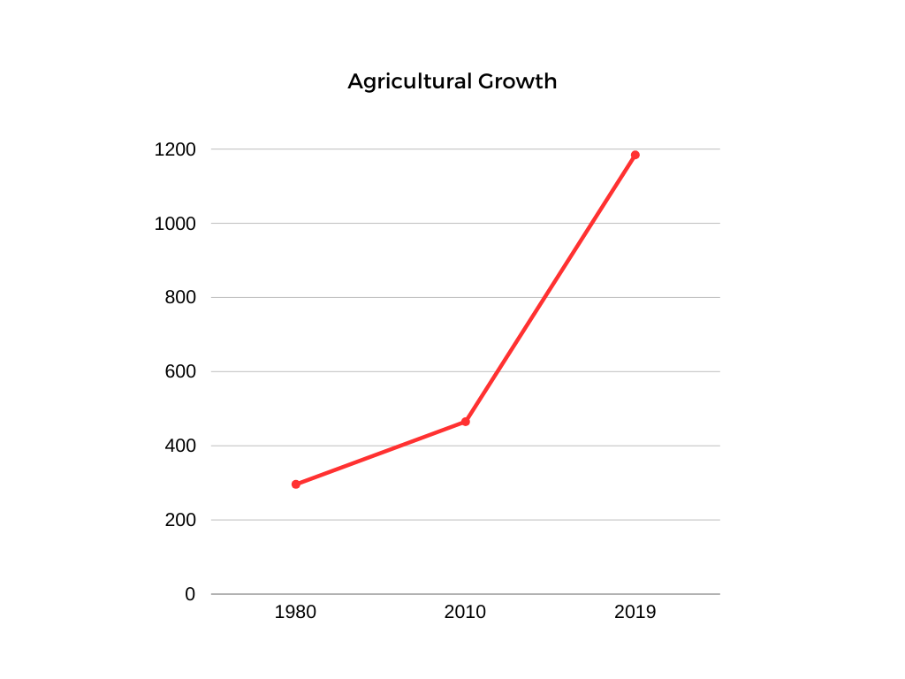
Agricultural Growth
Laos' Economic Growth (US$)
Laos' gross value per agricultural worker (Briones, 2013)
  $296 in 1980
  $465 in 2010
  $1,184.22 in 2019 (The World Bank, 2019)

Slide 9
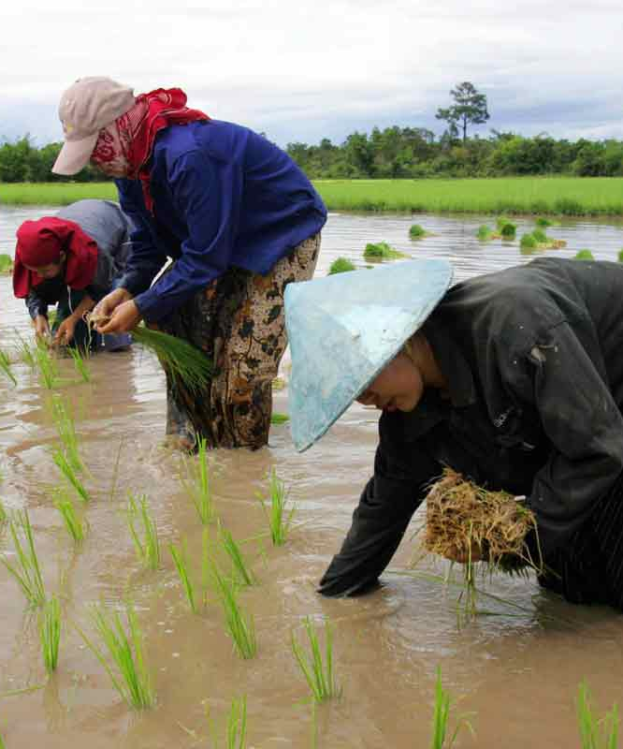
Economic Growth
Contract Farming
  Provides a guaranteed market for local farmers
  Local farmers will invest their land, while foreign agencies will provide the tools and seeds.
Free Trade
  Cut tariffs with Thailand and China, as well as other countries
  Lowered tariffs with the United States
Thomas, J. (2019). The ASEAN Post.
Thanichanon, P., Schmidt-Vogt, D., Epprecht, M., Heinimann, A., & Wiesmann, U. (2018). PLOS Journals.

Slide 10
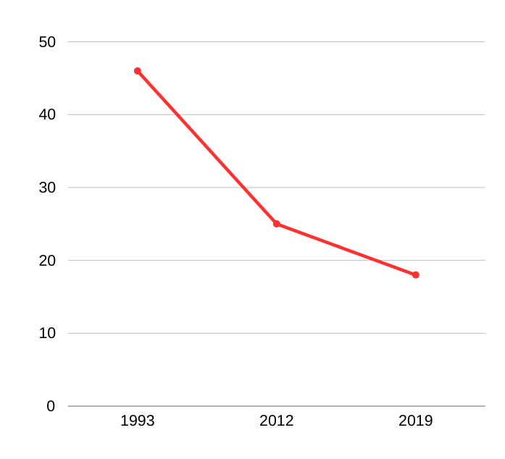
Laos' Economic Growth (US$)
Laos' Decline in Poverty (%)
(Briones, 2013; World Bank Group, 2019)
(Lao Statistics Bureau, 2019; World Bank Group, 2022)

Slide 11
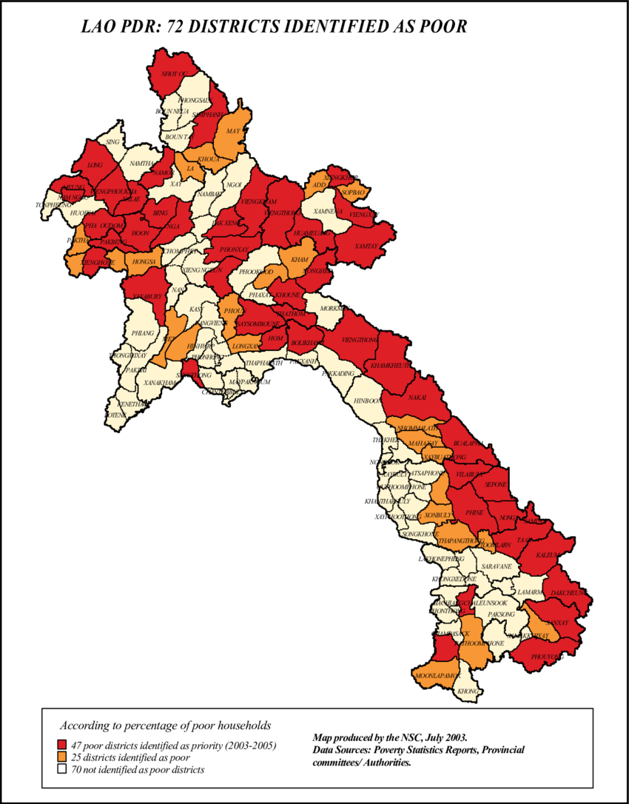
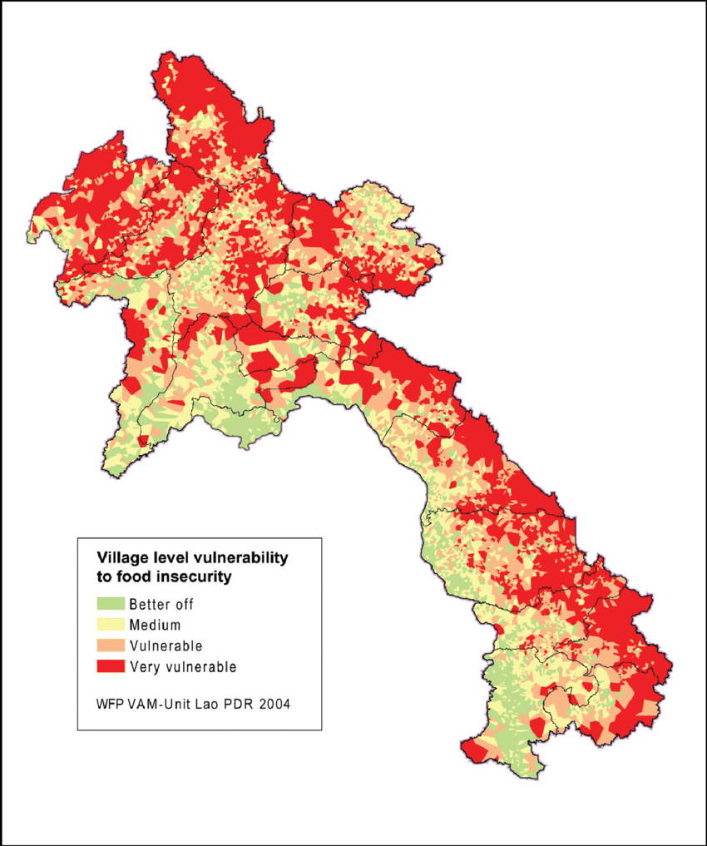
Epprecht, M., Minot, N., Dewina, R., Messerli, P., & Heinimann, A. (2008). The Geography of Poverty and Inequality in the Lao PDR. Research Gate.

Slide 12
Increased Risk of Food Insecurity
Vulnerability and food insecurity related to household welfare (Epprecht et al, 2008).
A growing concern in food insecurity as market failures reduce incomes and ability to buy food (Thanichanon et al., 2018).
Further intervention is necessary to bridge the gap between economic disparity (Alexander et al., 2017).

Slide 13
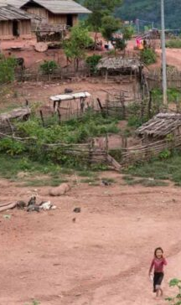
Discrepancy between Economic Growth and Prosperity
Although Lao PDR is experiencing exponential economic growth, the people of Laos are being left behind.
Laotian Times. (2022). USD 210 million spent on Poverty Reduction in Laos since 2003. Laotian Times.

Slide 14
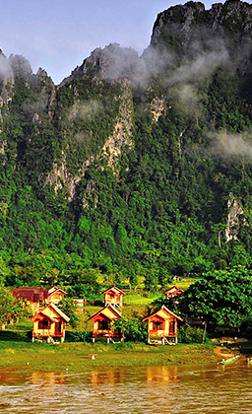
Effect on the Environment
Contradictions in policies versus practice
  Private and market sectors only concerned with output
  Land degradation and forest covers
Southavilay, B., Nanseki, T., & Takeuchi, S. (2013). Analysis on Policies and Agricultural Transition: Challenges in Promoting Sustainable Agriculture in Northern Laos. Fukuoka; Kyushu University Institutional Repository.
Stephen. (2018, September 10). Laos Weather & Climate. Indochina Tours.

Slide 15
Effect on the Environment
The Lao Land and Forest Allocation Policy (LFAP) and commodity production policies have resulted in food insecurity
  Rural livelihoods
  Limited farmland
Southavilay, B., Nanseki, T., & Takeuchi, S. (2013). Analysis on Policies and Agricultural Transition: Challenges in Promoting Sustainable Agriculture in Northern Laos. Fukuoka; Kyushu University Institutional Repository.

Slide 16

Conclusion
Land use and land allocation
Growing economic disparity
Food insecurity
Land degradation
Audley. (2022). Visit Vientiane, Laos: Tailor-made Vientiane Vacations. Audley Travel. https://www.audleytravel.com/us/laos/places-to-go/vientiane

Slide 17

Recommendation
Due to disconnect between Lao PDR and the welfare of
its people, I recommend an assessment into
  Government policies and their impact on environmental sustainability,
  Rural livelihoods and domestic development.
  Financial and technical assistance
  Infrastructure and system between rural farmers and local, regional, and/or global markets
  More regulations/standards for foreign agencies regarding land use and allocation

