Slide 1

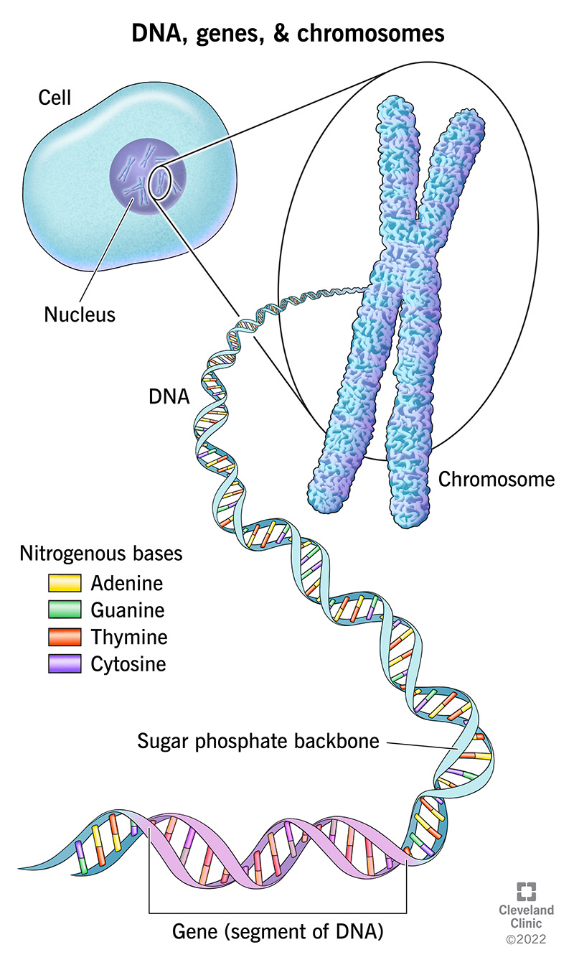
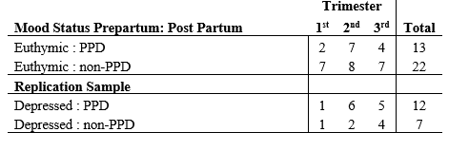
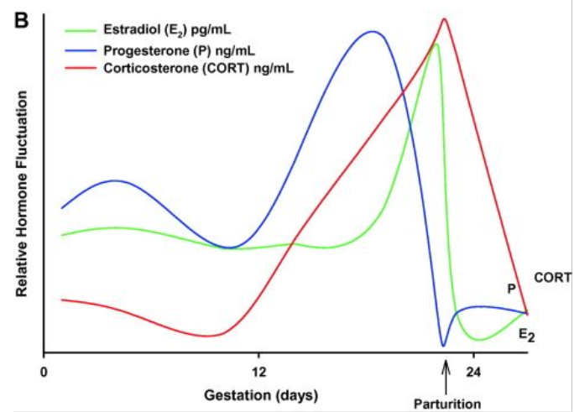
The Genetic Analysis of Postpartum Depression Through DNA Methylation​
Elizabeth Riffel
Biomedical Sciences
Figure 2: DNA, genes, and chromosomes visual breakdown.
ABSTRACT
STRACT
METHOD(S)
RESULTS AND DISCUSSION
Post partum depression (PPD) is a psychological disorder that develops during prepartum and postpartum. Notably, PPD shares close correlations to drops in gonadal hormones estradiol (E2) and progesterone (P4) (4). Symptoms of the disorder include depressive behaviors, mood swings, suicidal ideations, and difficulties bonding with the fetus (3). As a result, mothers with PPD can significantly hinder their newborns behavioral and emotional development (2). Within this study, it was hypothesized that the risk for PPD may be mediated by enhanced sensitivity to E2-mediated epigenetic reprogramming. Through manipulation of DNA methylation and E2 levels within 53 pregnant women and C57BL/6J mice, the hypothesis proved true.
This cross-species translational design study analyzed the differences in DNA methylation between C57BL/6J mice and 93 pregnant women. While 93 women were included in the study, only 54 with preexisting psychological disorders were considered in the results.
891 significant DMRs were identified: 511 exhibited an increase with 380 exhibiting a decrease in DNA methylation with respect to changes in E2 levels. Gostat analyzed many gene ontology (GO) categories near those identified DMRs. Enrichment of estrogen receptor transcription factor-binding motifs and SP-1 was identified through Motif Enrichment analysis of genomic sequences in estrogen receptor-β promoter methylation-correlated regions and E2 DMRs.
Genomic locations were cross-referenced between the human and mice species E2 DMRs. This revealed 1578 human CpGs were located within the mouse E2 DMRs of which one specific GO category and transcription factor binding motifs were discovered.
The mean DNA methylation difference with respect to E2 mediated DNA methylation fold change between PPD and non-PPD groups was compared. Within the 1578 overlapping loci, no correlations were identified. Data set was adjusted to 103 loci of which revealed DNA methylation rates are strongly associated with localization to syntenic regions of E2-mediated epigenetic reprogramming. It can be concluded enhanced sensitivity to E2 mediated epigenetic reprogramming shares close correlations with risk for PPD.
DNA methylation biomarkers HP1BP3 and TTC9B were discovered through an algorithm created by the researchers. Sodium bisulfite pyrosequencing was used to validate microarray findings within the human samples at CpG dinucleotides located within the region localized upstream on the DNA strand of TTC9B and HP1BP3. DNA methylation proved to be strongly associated with both genes with an 88% confidence.
Various percentages of differing cell types was also considered including CD8 T cells, CD4 T cells, B cells and monocytes. The study revealed that greater variance in differing cell types was prevalent within the groups without depression.
Table 1: Clinical sample collection data consisting of the 54 women considered in the analysis of the results displaying the trimester at which the blood samples were taken. 19 of which displayed depression symptoms with the remainder 35 diagnosed as euthymic women (bipolar disorder).
INTRODUCTION AND PURPOSE
Post partum depression (PPD) is a depressive psychological disorder that develops within the first year following birth (1). In the United States, 1 in 7 women are diagnosed with this disorder (2), though many women containing symptoms remain undiagnosed. Symptoms include depressive behaviors, mood swings, suicidal ideations, and increased difficulties bonding with the fetus (3). Not only does PPD impact the mother, but it also shares negative correlations to fetal development. Notably, infants impacted develop behavioral and emotional problems significantly hindering fetal development (2). Currently, reliable methods for predicting PPD and preventing the diagnosis are unavailable. Overall diagnosis of the patient follows the Diagnostic and Statistical Manual of Mental Health Disorders, Fourth Edition (DSM-IV). According to this criteria, PPD is prevalent for up to 4 weeks postpartum and is inflicted due to a vast decrease in estradiol (E2) and progesterone (P4) (4). While this method effectively diagnoses patients, reliable methods to prevent and predict PPD in women is nonexistent. Regarding this absence, it is important to note factors like external stressors, epigenetics, demographics, genetics, and psychiatric history are being researched (5). Notably, studies have found correlations between sudden gonadal hormone level drops and the prevalence of the disease. This study takes a closer look at the impact of epigenetics on predicting PPD with respect to E2 levels and DNA methylation.
Blood samples were taken from human specimens while hippocampal tissue from C57BL/6J mice was analyzed to compare the two. Notably, the mice were ovariectomized at 8 weeks of age. Within the surgical procedure, the mice were implanted with a silastic capsule containing 5mm of dry packed 17β-E2.
The mice endured Affymetrix DNA methylation profiling using Hpall and HinP1I enzymes. Unmethylated segments of DNA were hybridized to Affymetrix GeneChip Mouse Tiling Promoter 1.0R Arrays in which differentially methylated regions (DMRs) were identified. On the other hand, human specimens endured Illumina DNA Methylation Profiling in which methylation values were calculated in differing regions within the DNA sample.
The loci of 473 DNA methylation proxies was input to be quantified using the HM450 arrays. Sodium bisulfite pyrosequencing was utilized to implement differential DNA strands upon subsequent sequencing.
CONCLUSIONS
-The identification of biomarkers HP1BP3 and TTC9B genes share direct correlation to PPD prevalence in women with respect to altering E2 levels.
-Increased sensitivity to epigenetic reprogramming focalized on E2 levels can provide a molecular mechanism to predict PPD risk within different individuals.
-Estrogen levels following birth correlate to PPD
-Considering the small sample size, further studies will need to be conducted to confirm these findings and further implement this strategy as a reliable predictor for PPD.
PROPOSED SOLUTION
With respect to adopting the techniques practiced within this study to sufficiently predict PPD, more studies will have to be conducted to confirm this is a reliable technique. Though this study provides much headway on a prevalent issue impacting women and families in the United States.
Figure 1: Hormone fluctuation levels of Estradiol (E2), Progesterone (P4), and Corticosterone (CORT) during the gestational periods of a rat.
REFERENCES
1. Trifu, S., Vladuti, A., & Popescu, A. (2019). The neuroendocrinological aspects of pregnancy and postpartum depression. Acta endocrinologica (Bucharest, Romania : 2005). https://www.ncbi.nlm.nih.gov/pmc/articles/PMC6992410/#:~:text=Hormonal%20changes%20during%20labour%20and%20postpartum&text=Progesterone%20is%20the%20most%20abundant,a%20role%20in%20postpartum%20depression
2. American Psychological Association. (2022, November 2). Postpartum depression: Causes, symptoms, risk factors, and treatment options. American Psychological Association. https://www.apa.org/topics/women-girls/postpartum-depression
3. Mayo Foundation for Medical Education and Research. (2022, November 24). Postpartum depression. Mayo Clinic. https://www.mayoclinic.org/diseases-conditions/postpartum-depression/symptoms-causes/syc-20376617#:~:text=Physical%20changes.,feeling%20tired%2C%20sluggish%20and%20depressed
4. Guintivano, J, Arad, M., Gould, T. D., Payne, J. L., & Kaminsky, Z. A. (2013, May 21). Antenatal prediction of postpartum depression with blood DNA methylation biomarkers. Nature News. https://www.nature.com/articles/mp201362
5. & Table 1: Guintivano, J., Manuck, T., & Meltzer-Brody, S. (2018, September). Predictors of postpartum depression: A comprehensive review of the last decade of evidence. Clinical obstetrics and gynecology. https://www.ncbi.nlm.nih.gov/pmc/articles/PMC6059965/#R9
Figure 1: Bakker, J., Bale, T. L., Bao, A. M., Barha, C. K., Barker, J. M., Bloch, M., Bowman, R. E., Brannvall, K., Brummelte, S., Brusco, J., Butz, M., Cameron, H. A., Carter, C. S., Czeh, B., Darnaudery, M., Driscoll, I., Epp, J. R., Falconer, E. M., Furuta, M., … Brown, J. P. (2009, April 8). Effects of steroid hormones on neurogenesis in the hippocampus of the adult female rodent during the estrous cycle, pregnancy, lactation and aging. Frontiers in Neuroendocrinology. https://www.sciencedirect.com/science/article/pii/S0091302209000053?casa_token=5fdwuQIzbvMAAAAA%3A_m3Nb9Eb3075gGmRmq3PQ3IDn0oR22EtYcG5DdiVG6kX-D24A4IM2D3yn-z8_RjHzo_PJ2UyhLg
Figure 2: professional, C. C. medical. (2022, May). DNA vs genes VS chromosomes: An overview. Cleveland Clinic. https://my.clevelandclinic.org/health/body/23064-dna-genes--chromosomes

