Slide 1

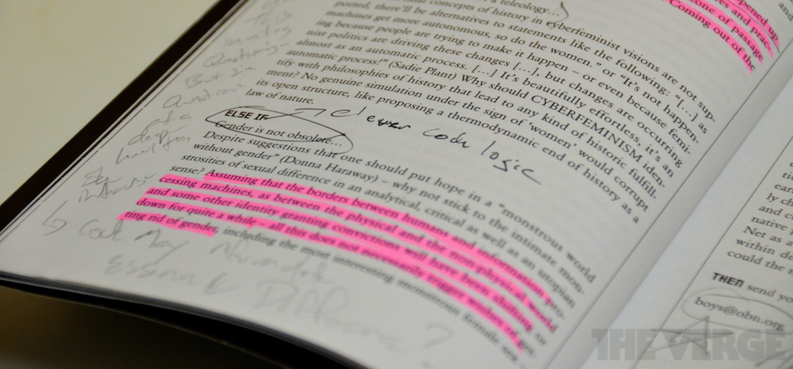
UW Tacoma CTC Meeting
Active Reading
Wes J. Lloyd
Institute of Technology
University of Washington – Tacoma
Winter 2017

Slide 2
objectives
E-reading
Paper as a technology
Activating reading

Slide 3


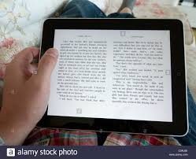
E-reading
The proliferation of the internet has moved inquiry, reading, research online
How does this change student interaction with the text?
Is online reading engaging student’s minds?

Slide 4
E-Readers
Rapid advancements enable e-readers to be viable replacements for paper
Previous changes in reading technology took centuries to evolve and spread
  Scrolls
  Hard-cover books
  Paper-back books: lighter, compact, less expensive
  E-Readers

Slide 5
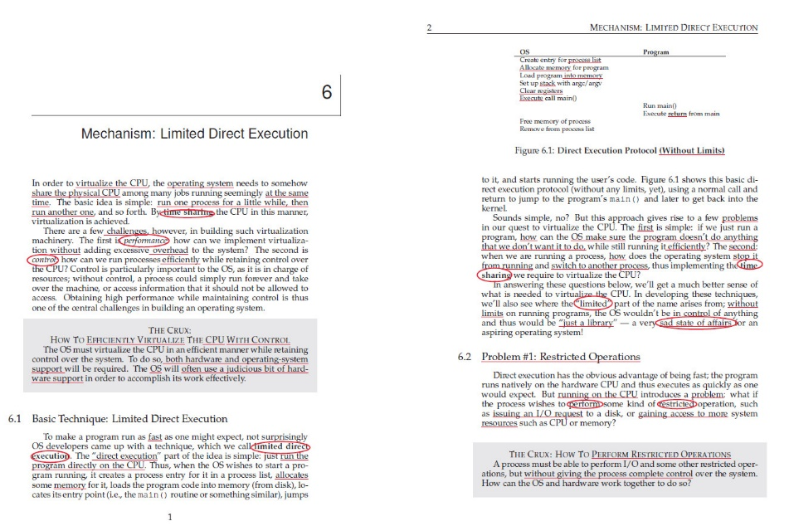
E-reader features
Electronic highlighting / Social highlighting
  Data regarding commonly highlighted text collected and shared
Typed notes: can be entered for various sections
Online dictionary: tap a word to see its definition
Tweet/post quotes from books
Search: similar to word processor
Variable font sizes
Concerns
  Reading history shared

Slide 6
Paper as a technology
Paper as a medium has benefits
Display features
  Very high contrast display, readable with any form of light
  Supports large number of colors and also B&W images
  Offers spatial layout for immediate access to information
  Immersive and non-distracting user interface
  Easy to learn UI consistent across most manufacturers
  Supports direct interaction via pen or highlighter
  Compatible with a wide variety of note taking systems

Slide 7
Paper as a technology
Reliability, durability, maintenance
  No battery power required
  Depending on model, lasts from 5 to 5,000 years or more
  Crash-proof, immune to viruses (though vulnerable to worms)
Reusability, extensibility
  No digital rights to manage: easy to lend or sell
  Open standard- no lock-in to a specific vendor or technology

Slide 8
The passive reading problem
Are eReaders, eBooks, and internet browsers as effective as physical print in engaging students actively with the text to aid learning?
Is e-reading more passive cognitively?
How can we be sure students are engaging with the material for reading assignments?
ACTIVE READING

Slide 9
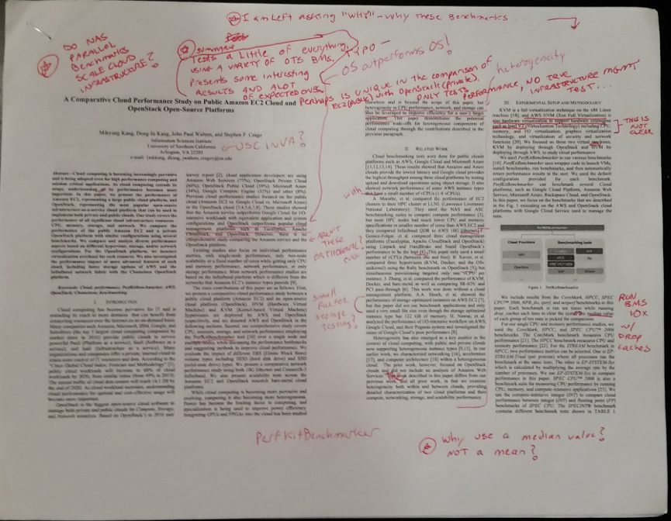
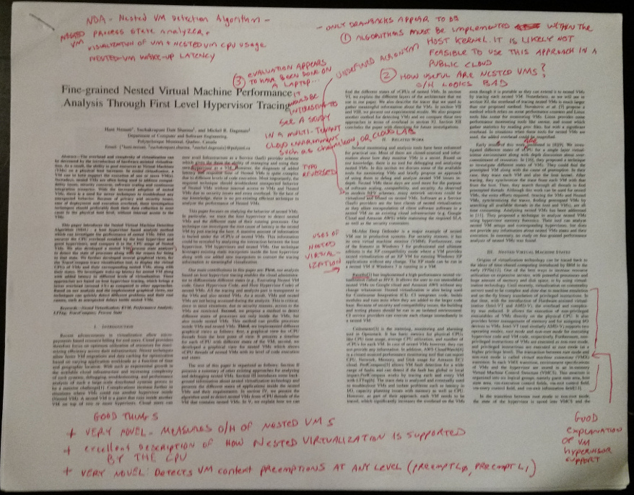
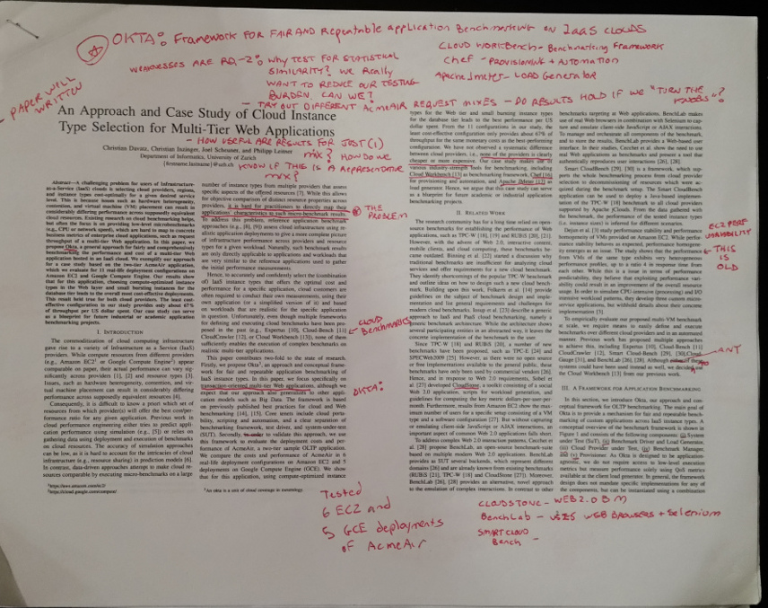
Active Reading
General idea gleaned from research paper review techniques…
Mark up key ideas
Identify questions
Mark unclear concepts
Look up unknown terminology to aid in the review process

Slide 10
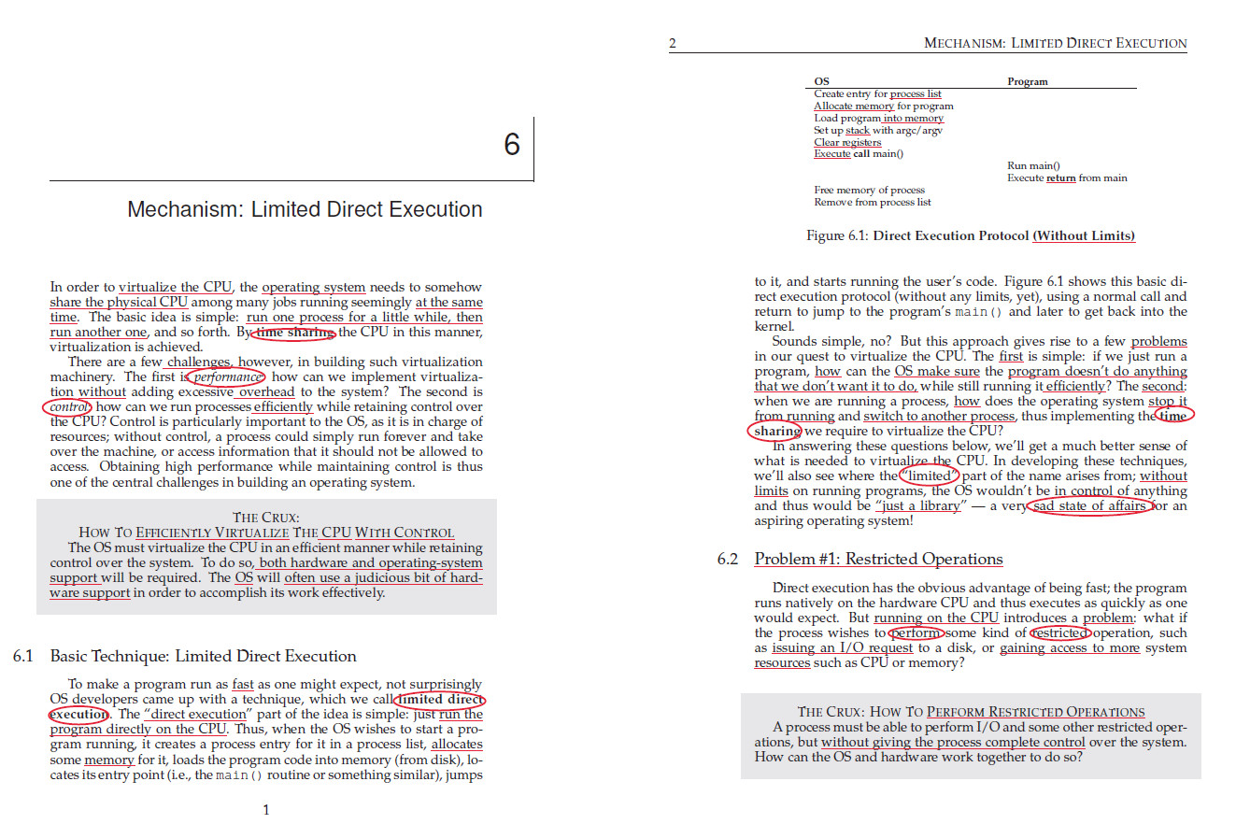
Two-up format
When content is not from a book, or is from online books, try using 2-up PDFs / printouts
Post online for
student access
Provides additional
margin space for
markup/comments

Slide 11
aCTIVE READING:
Tradeoff space
Encourage students to engage and even own the text
Read the
chapter
Critique the
chapter
Passive
Active
Low retention
of concepts
High retention
of concepts
Low
effort/time
High effort/time

Slide 12
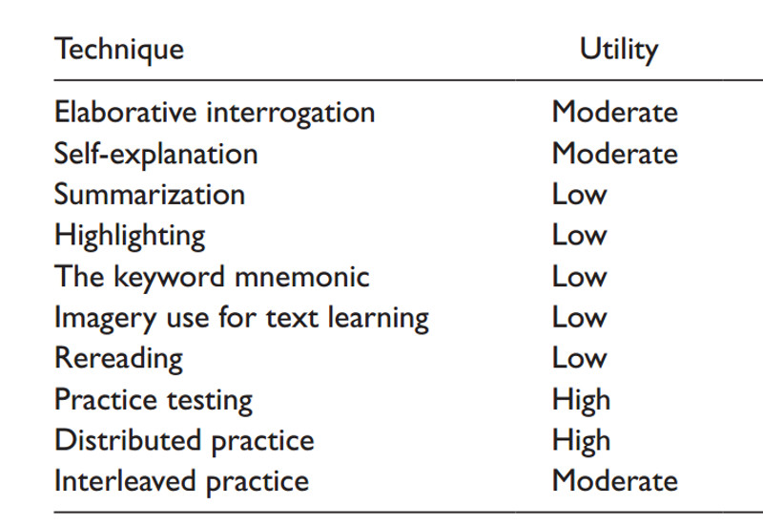
“Activating” reading
From: Dunlosky, John, et al. "Improving students’ learning with effective learning techniques: Promising directions from cognitive and educational psychology." Psychological Science in the Public Interest 14.1 (2013): 4-58.
Repurposing traditional
reading assignments to
become active reading
changes the cognitive
tasks involved with the
goal of improving the
learning outcome…

Slide 13
Active reading
Primary goal is to approach reading from the role of a reviewer
  In contrast to a passive reader
“Imagine you are an editor, or if you just hired someone to write a technical manual. You are now reviewing their work for clarity and understandability.”
Active reading can help you read and better understand technical documentation which you may encounter at a job in the future.
Similar to critical reading:
  https://en.wikipedia.org/wiki/Critical_reading

Slide 14
Active reading: REVIEW PHASE
Consider how the author has presented the information
When something is unclear, mark this…
If something is hard to understand, rephrase it in layperson terms. (in the margins) State what the text means to you.
Circle key terms, underline key ideas, do not highlight.
Mark typographical/grammar errors
Look up definitions of vague terms and write short definitions in the margins
Star and circle the key ideas and takeaways… This helps to see them very quickly when reviewing the chapter again.
Write and summarize key concepts in the margins
Use the markup to write a summary…

Slide 15
Active reading: writing phase
Task 1: Write 1-3 sentences summarizing what the chapter is about. Summary should describe what the chapter is about. Someone who is looking for information on the topics and ideas you identify should be encouraged to read the chapter after reading your summary.
Task 2: List 3 or more key concepts from the chapter, and describe them.
Task 3: List 3 or more words / terms and their definitions you’ve looked up while reading the chapter.

Slide 16
Active reading: write phase - 2
Task 4: Look up a technology or topic from the chapter online and write (2-3) sentences describing it in more detail.
Answer:
  What it does?
  Why is it important?
  Cite sources
Task 5: After reading the chapter, write two questions about ideas or related concepts you’re unsure of. You may have an idea what the answers are, but you’re not entirely sure.
  Conduct research online to attempt to answer your questions. Write a summary of your answer, and why you think so.
  Cite sources
  Bring up your questions in class

Slide 17
Feedback from students
From TCSS 422 – Operating Systems Fall 2016
Dr. Lloyd,
This was the first time I've ever had a quiz structured in such a manner, even for a take home quiz. For time I spent working on this quiz compared to other courses where I needed to instead "study" for a quiz, I spent noticeably more time. However, it felt significantly more productive.
With traditional quizzes, I usually skim the material; trying to memorize everything, but not really understanding it all. I've never liked traditional quizzes because my study strategy was quantity over quality, because you never knew what to expect to be covered on the quiz. And some take home quizzes just test my ability to utilize ctrl-f.
Even though I spent more time working on this quiz, I feel like I have a deeper understanding of the chapter, and making me find questions helps me explore more about concepts I read about. I hope to see more of these in the future.

Slide 18
resources
Improving Students’ Learning With Effective Learning Techniques: Promising Directions From Cognitive and Educational Psychology
http://www.psychologicalscience.org/publications/journals/pspi/learning-techniques.html#.WK_iRBIrJWM
Samples
http://faculty.washington.edu/wlloyd/courses/tcss422/quiz/
TCSS422_w2017_Quiz_1.pdf
http://faculty.washington.edu/wlloyd/courses/tcss422/quiz/
TCSS422_w2017_Quiz_4.pdf
http://faculty.washington.edu/wlloyd

Slide 19
Questions

