Slide 1
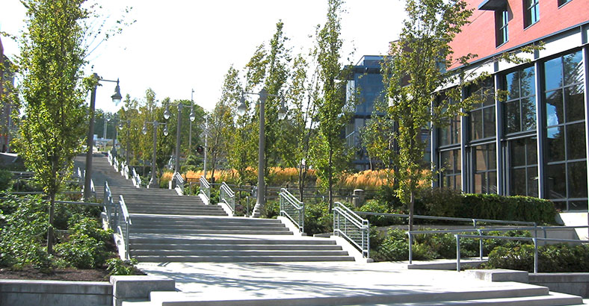
Mental Health and COVID Pandemic:
Findings from the 2021 COVID-19 UWT Faculty Needs Assessment/Impact Survey
UW Tacoma Faculty Affairs Committee:
Y. Dierwechter, C. Knaus, W. Cheng, K. Cruz, E. Feroz, S. Oswal (A. Miller), M. Bergman
Sharon Laing, Chair

Slide 3
Demographics

Slide 4
Demographics

Slide 5
UWT Faculty Experience

Slide 6
Personal COVID-19 Deaths
Caretaking Emotional Toll
Emotional Challenges
Enhanced Student Support
Physical Health and In-Person Teaching
Enhanced Professional Roles

Slide 7
COVID-Related Grief and Depression
Faculty report grief, depression, and anxiety
67% experienced mental health challenges (57% moderate to high)
63% experienced feelings of isolation (43% moderate to high)
  Faculty report family members, friends and colleagues who died from COVID-19
  Faculty express fears of contracting the virus on campus and transmitting to vulnerable family members

Slide 8
Caregiving/Taking Roles and Anxieties
Caretaking and Attendant Emotional Toll
48% of faculty report being primary caregiver/caretaker in households
  40% report substantial increases in caretaking/caregiving time
  Faculty report emotional vulnerabilities of parenting young children during the pandemic
    How to manage schooling and mental health challenges of their young children while at home
  Faculty report emotional distress related to the potential risk of exposure to unvaccinated children/infants
  Faculty report immunocompromised spouses and/or elderly household members

Slide 9
Emotional Toll Related to Workload and Student Support
Emotional challenges heightened due to students in crisis…
75% report the challenge of navigating increased workload associated with heightened student support (68% moderate to high)
74% report challenges associated with increased classroom responsibilities
47% report student backlash from poor evaluations
43% report increased service load to address COVID-related needs

Slide 10
Professional Roles
Heightened emotional labor due to enhanced departmental-level responsibilities and challenges…
  Faculty report an increase in mentoring and supporting struggling peers/colleagues
  Report an increase in turn-over in departments/Schools
  Report lack of adjustments by departments to help manage additional burdens sustained

Slide 11
Anxieties Linked to Physical Health and In-Person Instruction
Anxieties related to in-person instruction and physical health
  62% of faculty report physical health challenges (42% moderate to high)
    Faculty who are immune-compromised expressed concerns about in-person instruction
    Faculty who learned of break-through infections in their Schools were especially anxious
  Faculty report anxieties linked to disease transmission to compromised family members

Slide 12
Supports Sought

Slide 13
Supports Required
Faculty request information about available mental health resources and ways to access
Faculty request allocation of time by Schools to address mental health care needs
Faculty request guidance on accessing confidential and free telehealth support services

Slide 14
Supports Required
Faculty request guidance on accessing culturally competent therapy including resources to support LGBTQ and BIPOC communities
Faculty request guidance on re-orienting their mindset/cognitions to the current ‘normal’ permitting them to function during this time of COVID-19

Slide 15
Supports Required
Faculty request robust, faculty-centered mental health support network
Faculty request formalized networks of social support where participants are comfortable sharing hardships and coping strategies

Slide 16
Moving Forward…
Strategies to Support UWT Faculty…

